Slide 1
When it comes to car crashes, when do injuries occur? What about fatalities?
An Investigation by Nabil Darwich and Hamza Mughal
Using real crash data from the City of Chicago from the summer of 2018

Slide 2
Finding a Good Dataset
Original Data: Montgomery County’s Traffic Violations https://data.montgomerycountymd.gov/Public-Safety/Traffic-Violations/4mse-ku6q
Violation info from all electronic traffic violations in Montgomery County
1m+ records
Significant Columns:
Geolocation
Time of stop
Accident (Y/N)
Belts (Y/N)
Personal Injury (Y/N)
Fatal (Y/N)
Alcohol (Y/N)
Driver race/gender/city/state
Vehicle make/model/year/type

Slide 3
Why We Switched
Many Inconsistencies, lack of good management/verification
The Accident Column never had a YES, even when fatalities occurred
Drivers were charged with DUI/DWI, but the Alcohol column indicated NO
Seatbelt violations when Seatbelt column indicated a seatbelt was worn
Overall improperly recorded data
No data on vehicle passengers/pedestrians involved
Lack of a standardized format
Descriptions sometimes included spelling errors
Info was sometimes entered by a human, causing subjectivity
Too many non-accidents, useless for our problem statement
Not enough relevant columns to build a good model

Slide 4
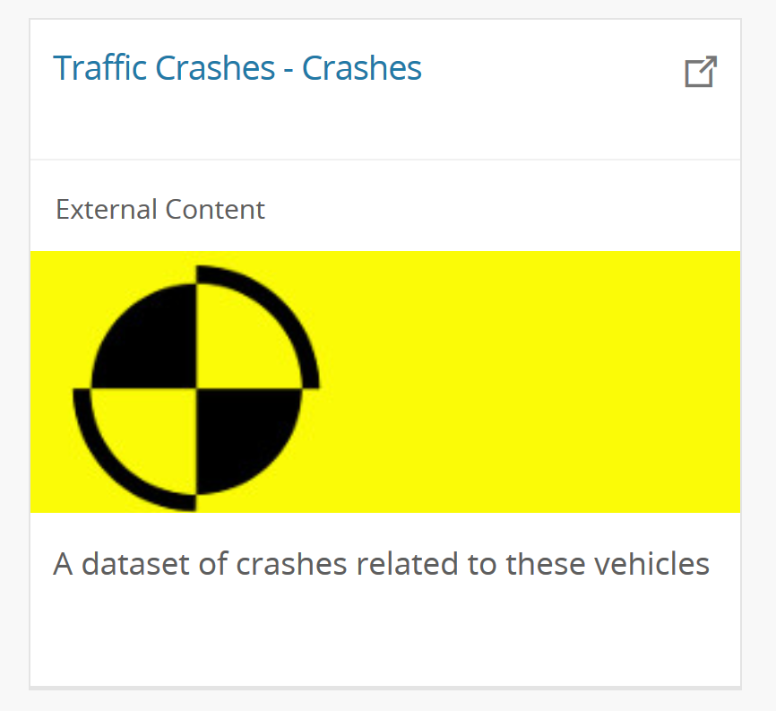
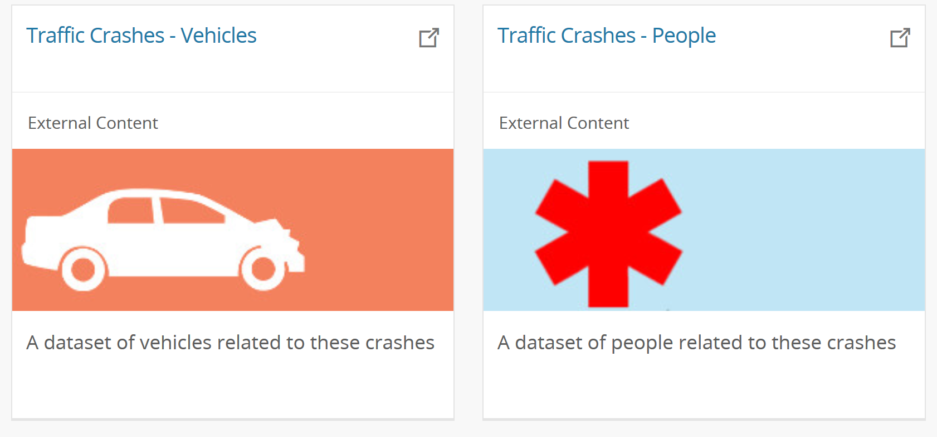
New Data: Traffic Crashes from the City of Chicago
Not only one dataset, but 3
Dataset about the crash
RD_NO, DATE, ROAD_DEFECT, TYPE, WEATHER. LIGHTING, PRIM_CAUSE, …

Slide 5
New Data: Traffic Crashes from the City of Chicago
Not only one dataset, but 3
Dataset about the crash
RD_NO, DATE, ROAD_DEFECT, TYPE, WEATHER. LIGHTING, PRIM_CAUSE, …
Dataset about the vehicles involved
RD_NO, NUM_PASSENGERS, MAKE, MODEL, EXCEED_SPEED_LIMIT, …

Slide 6
New Data: Traffic Crashes from the City of Chicago
Not only one dataset, but 3
Dataset about the crash
RD_NO, DATE, ROAD_DEFECT, TYPE, WEATHER. LIGHTING, PRIM_CAUSE, …
Dataset about the vehicles involved
RD_NO, NUM_PASSENGERS, MAKE, MODEL, EXCEED_SPEED_LIMIT, …
Dataset about the individuals involved
RD_NO, SEX, AGE, PERSON_TYPE (DRIVER/PASSENGER/PED), BAC_RESULT, …

Slide 7
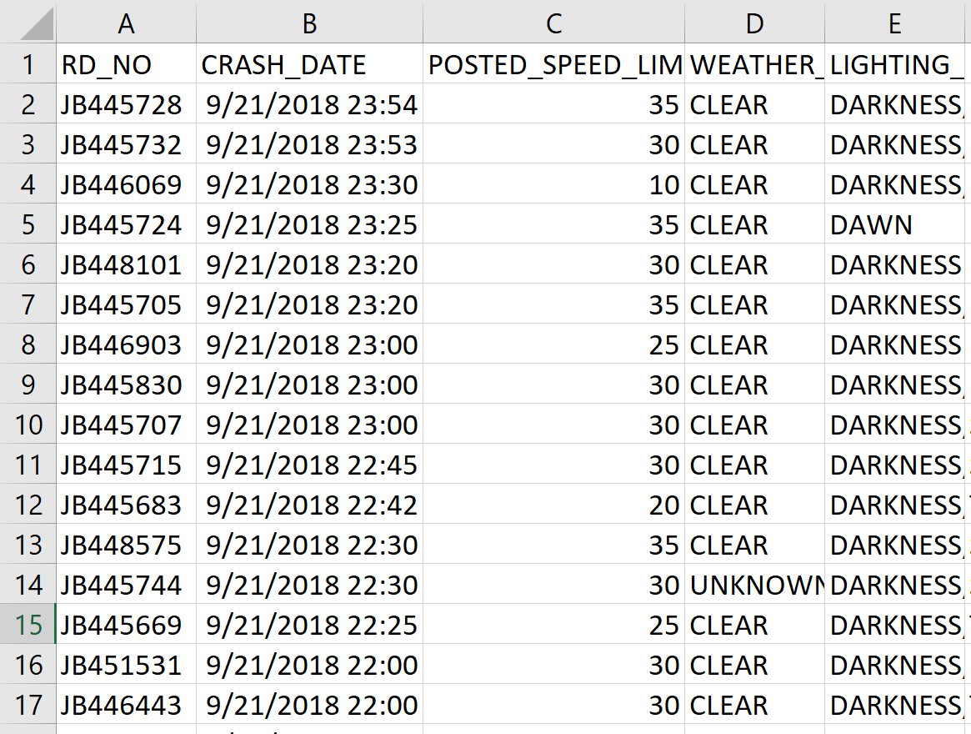
Traffic Crashes
200k+ records
Consistent
Uniform
Standardized

Slide 8
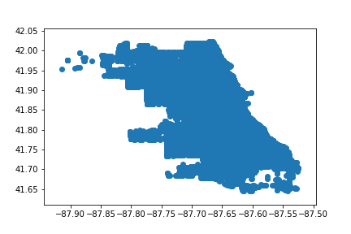
Traffic Crashes - Visualization
Plot crash geolocations on graph

Slide 9
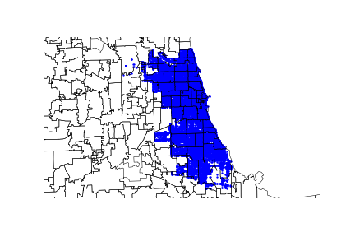
Traffic Crashes - Visualization
Plot crash geolocations on graph
Not very meaningful, plot against a map…
More details! Southeast Chicago seemed to be free from crashes, why?

Slide 10
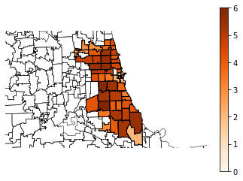
Traffic Crashes - Visualization
Plot crash geolocations on graph
Not very meaningful, plot against a map
More details, Southeast Chicago seemed to be free from crashes
Plot Chicago population density data

Slide 11
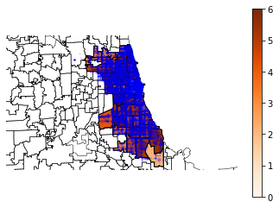
Traffic Crashes - Visualization
Plot crash geolocations on graph
Not very meaningful, plot against a map
More details, Southeast Chicago seemed to be free from crashes
Plot Chicago population density data
Plot crashes with population densities

Slide 12
Traffic Crashes - Preprocessing

Slide 13
Traffic Crashes - Preprocessing

Slide 14
Traffic Crashes - Preprocessing

Slide 15
Traffic Crashes - Preprocessing

Slide 16
Traffic Crashes - Preprocessing

Slide 17
Traffic Crashes - Transformation

Slide 18
Traffic Crashes - Transformation

Slide 19
Traffic Crashes – Data Mining

Slide 20
Traffic Crashes – Data Mining

Slide 21
Traffic Crashes – Data Mining

Slide 22
Traffic Crashes – Data Mining

Slide 23
Traffic Crashes – Evaluation

Slide 24
Traffic Crashes – Evaluation

Slide 25
Traffic Crashes – Interpretation

Slide 26
Traffic Crashes – Interpretation

Slide 27
Next Steps
Apply a similar algorithm to Fall/Winter/Spring Crashes

